Slide 1
ESFP-2 PROJECT
ONLINE FOOD MANAGEMENT SYSTEM

Slide 2

FLOW CHART

Slide 3
Algorithm
Step1 : Read all the required inputs from the users and save them in class array object with the help of class functions.
Step2 : The information in validated at the time of the input.
Step3 : Give your choice in the main menu as per your requirements.
Step4 : Process the data according to the given conditions.
Step5: Create object of ofstream to write the output in the file.
Step6: Print all the data in the file with the class function created and close the object.
Step7: exit from the main menu to terminate the program.

Slide 4
Library files included
#include<iostream> for basic input and output services.
#include<cstring> for string.
#include<fstream> for file handling.
#include<cstdlib> contains functions like memory allocation and other more.

Slide 5
FUNCTIONS OF CLASS ONLINE_FOOD_MGMT
VOID BASIC()-For basic info of customer.
VOID PRODUCT()-for order details.
VOID PART2()-additional details of order.
VOID DISPLAY()-displaying on terminal.
VOID FILE_DISPLAY()-Printing in file.

Slide 6
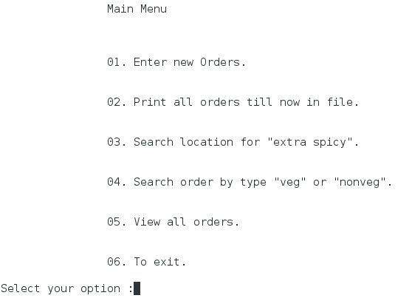
Main Menu

Slide 7
Option 2
Option 1
It is used for taking new orders from the user. The orders get appended one after the other.
It first asks the user the number of orders to be given.
It is used for print all the read orders into the file.
The outputs will be appended.

Slide 8
Option 5
Option 3 and 4
This options are used to satisfy the given conditions in the program’s Question.
It is used for print all the read orders on the terminal window.
Option 6
Exit the program.

